Slide 1
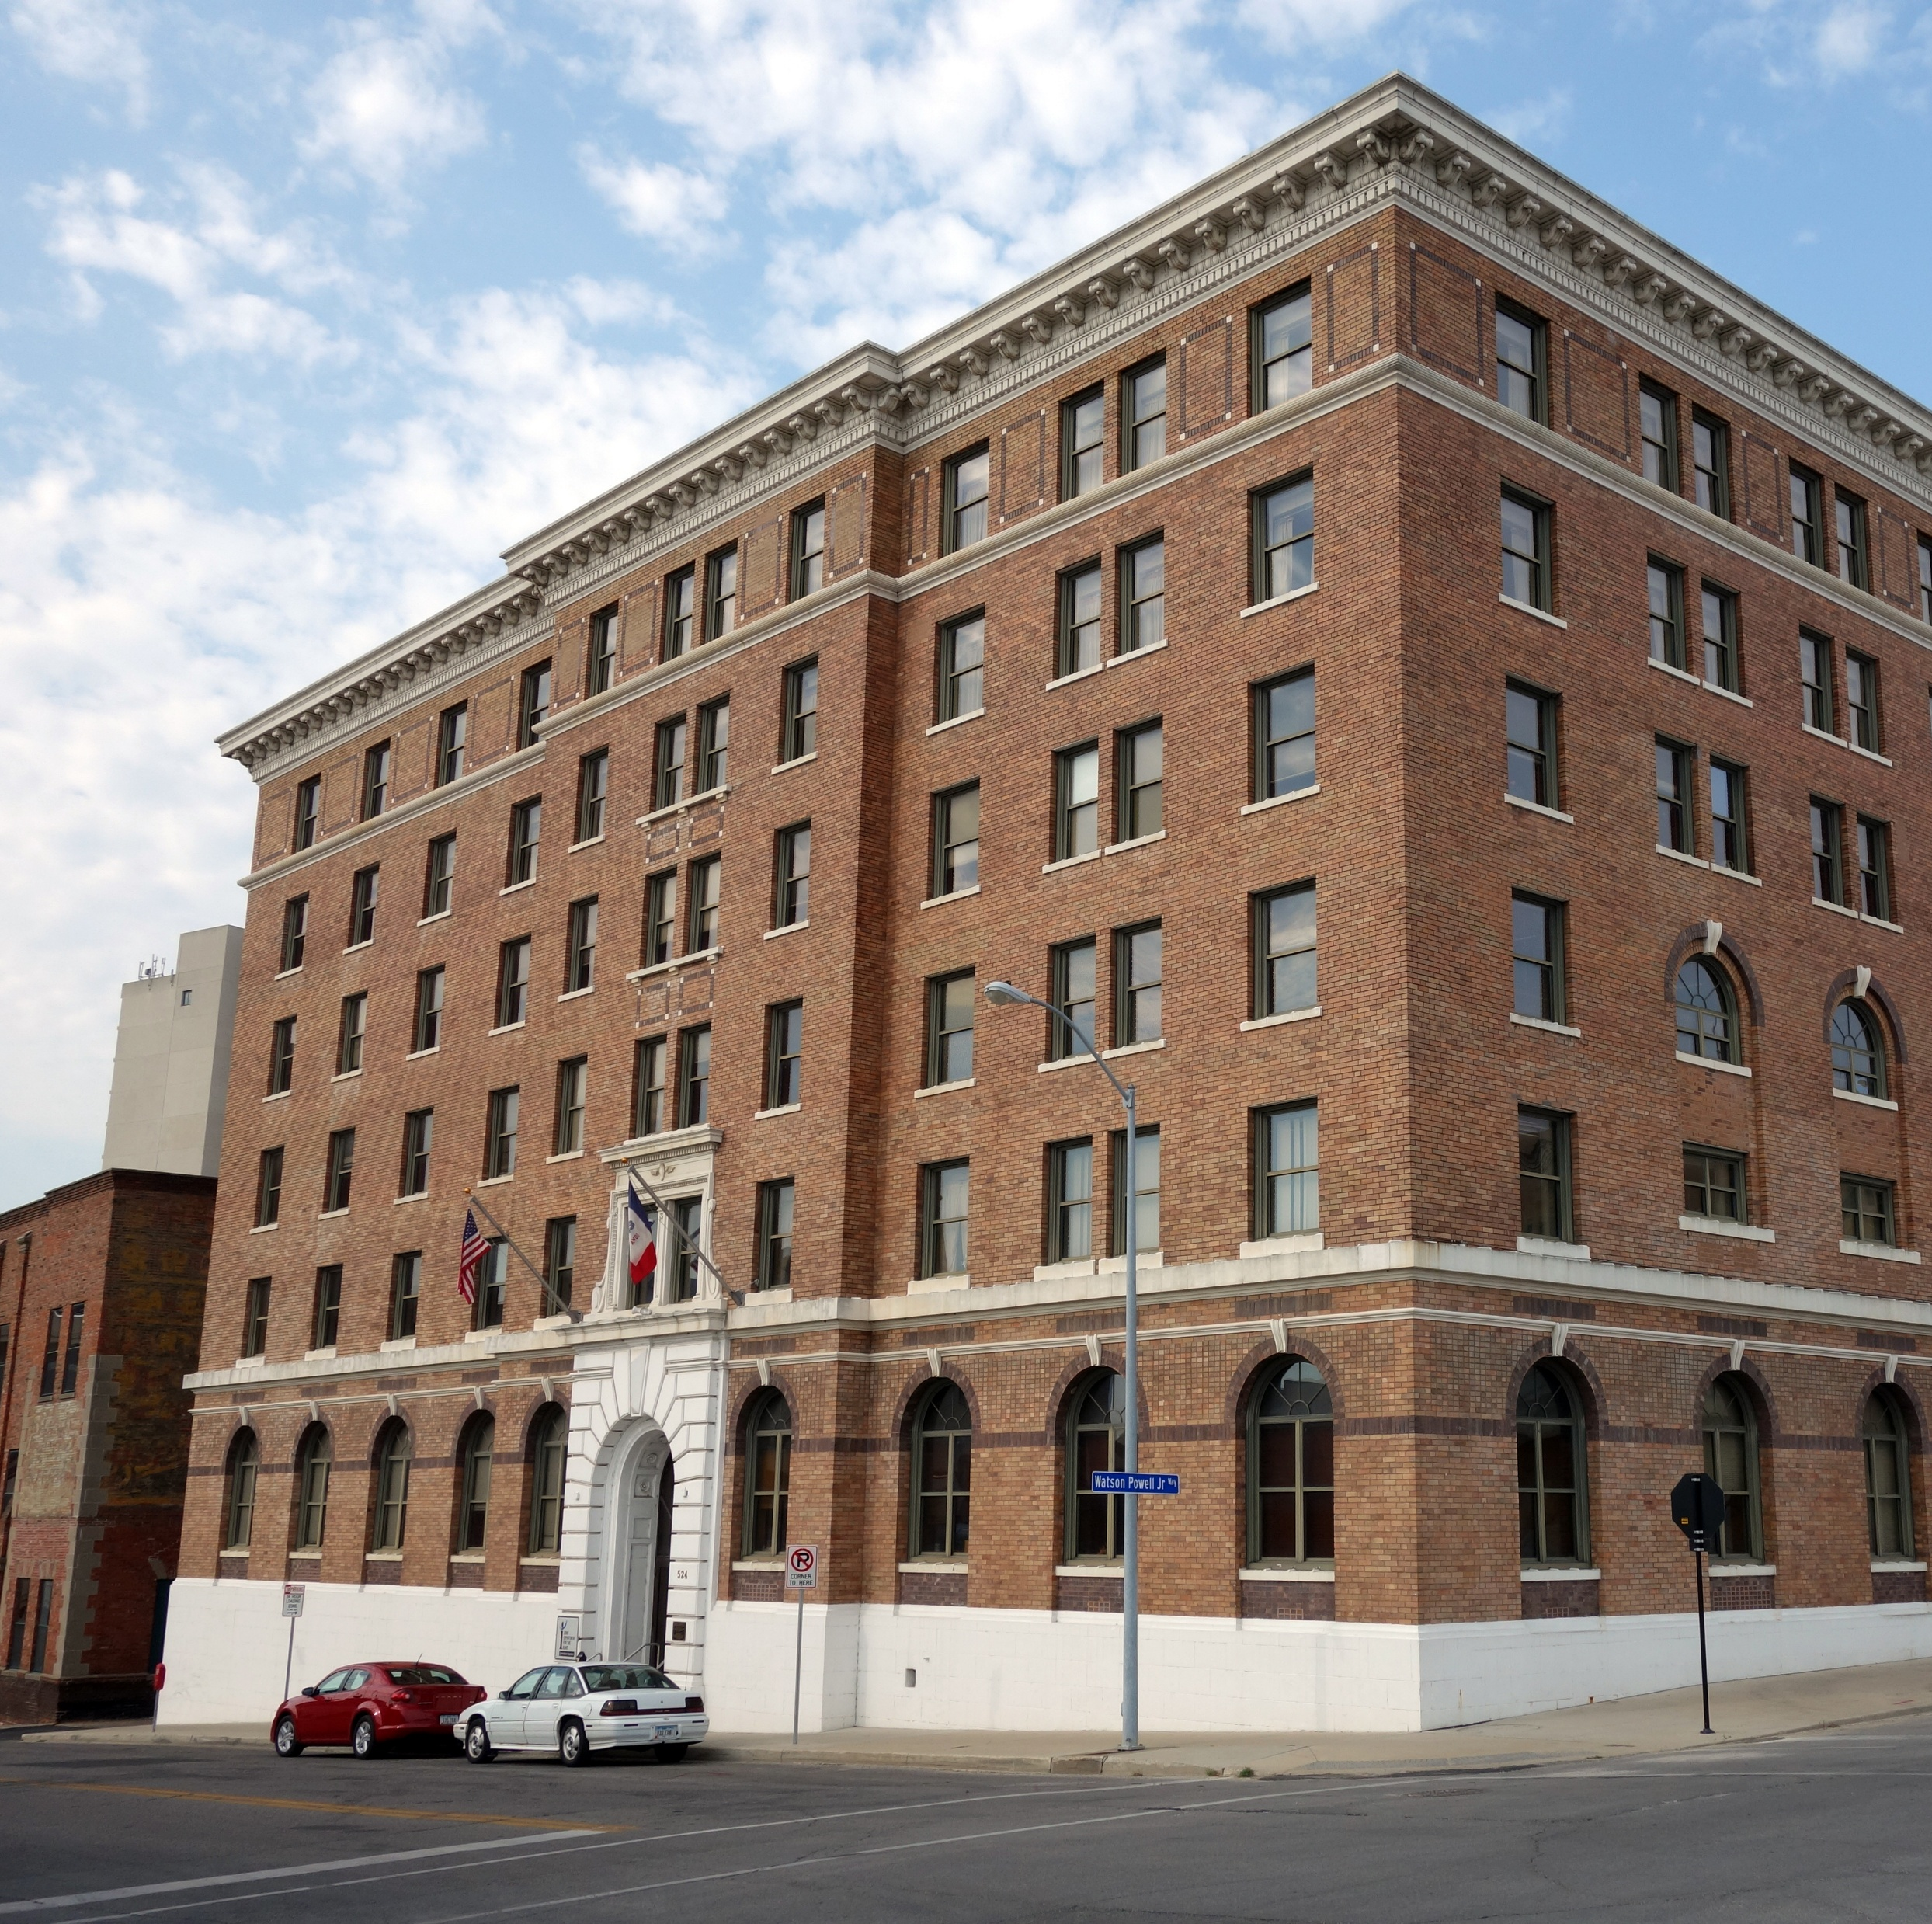

Iowa Department for the Blind
Strategic Plan

Slide 2
IDB Strategic Planning
Thank you for participating in the strategic planning process. Your insights and contributions have been invaluable. As a result of this process, we have identified our Mission Statement, Vision Statement, Value Statements, and Organizational Curlture Statement. We look forward to your continued involvement in bringing these initiatives to fruition. Your input has been critical in shaping a strategy that reflects our shared goals.

Slide 3
Mission Statement:
Empowering blind Iowans to work, live independently, and pursue the lives they choose.

Slide 4
Vision Statement:
A future where every blind Iowan can build a career, contribute their talents, and thrive in their communities.

Slide 5
Value Statements
Empowerment- We believe in equipping blind Iowans with the tools, skills, and opportunities to succeed in the workforce and community.
Independence- We believe that, with training and opportunity, blind people can do what they want to do and live the lives they choose.
Respect- We treat all people with dignity, empathy, and professionalism, recognizing the inherent worth and potential of each client, colleague, partner, and community member.
Integrity- We do what is right and we remain true to our mission and values.
Innovation- We embrace creativity, technology, and new ideas to create opportunities, remove barriers, and enhance the effectiveness of our services.
Opportunities- We expand access to employment, education, training, and community participation for all blind Iowans.
Informed Choice- We respect each person’s right to make well-informed decisions about their own rehabilitation and life.

Slide 6
Organizational Culture Statement:
We create a supportive environment where both staff and clients are valued, respected, and empowered to grow. When we care for each other, we make a more positive impact.

